Slide 1
Law in America

Slide 2
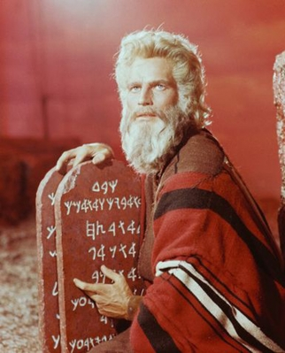
Early Systems of Law
Code of Hammurabi
categorized crimes
10 Commandments
individual responsibility

Slide 3
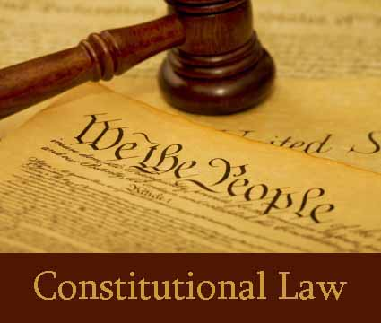
Constitutional Law
Laws that interpret state and national constitutions

Slide 4
Statutory Law
Statute - written by a legislative branch of government
Ordinance – passed at city level
Justinian/Napoleonic Codes are examples

Slide 5
Administrative Law
Laws that tell the authority of government agencies
Laws effect people directly ($)

Slide 6
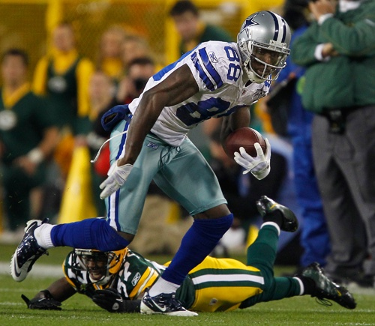
Equity
Rules created over time that overrule common law
Principals; just doing what is “right”

Slide 7
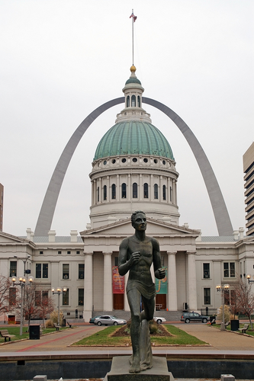
Legal System Principles
Four principles to how the courts operate…….

Slide 8
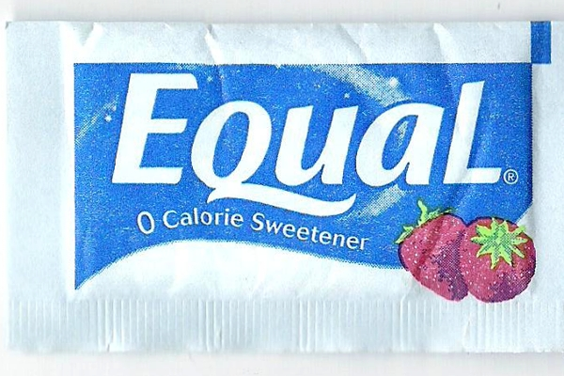
Equal Justice Under the Law
Goal: Treat all persons alike regardless of wealth, social status, race, gender, age, religion, etc

Slide 9
Due Process of Law
“Equal Justice”
Substantive – specific or implied in constitution
Procedural – fairness of way case is handled (

Slide 10
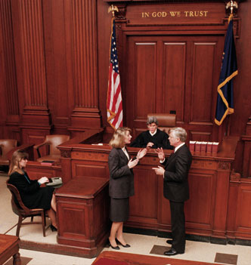
The Adversary System
Lawyers compete in “arena” and best job wins
Encourage lawyers to ignore facts to win…..or help them to bring all facts out

Slide 11
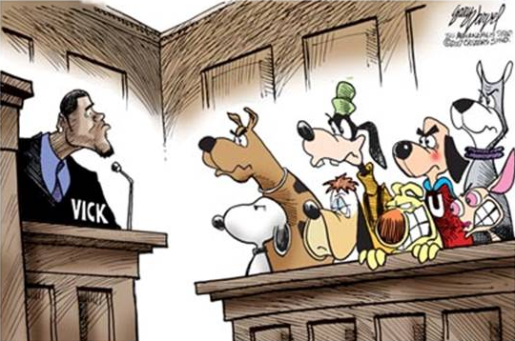
Presumption of Innocence
Innocent until proven guilty
Not in constitution just strongly rooted in our heritage

Slide 12
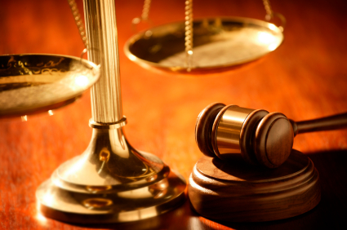
Civil Law

Slide 13
Contracts
Voluntary promises between parties who agree to do certain things
Express – terms specifically stated
Implied – terms inferred
What do we sign contracts for???

Slide 14
Property Law
Real Property – land and whatever is attached to it
Personal Property – all other (clothes, cars, etc)
Gov’t creates laws concerning buying land etc

Slide 15
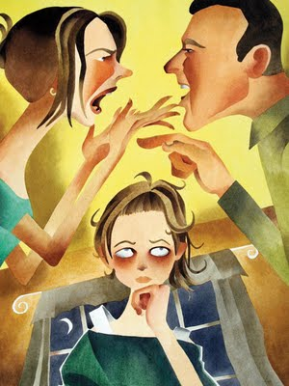
Family Law
Marriage, divorce, child custody, child support, etc
Changes – common law marriage, gay marriage

Slide 16
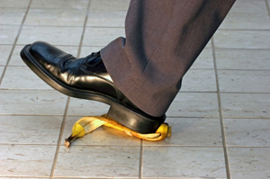
Torts or Civil Wrongs
Tort – wrongful act one can sue for damages (car wreck, icy sidewalk)
Intentional
Unintentional (negligence)

Slide 17
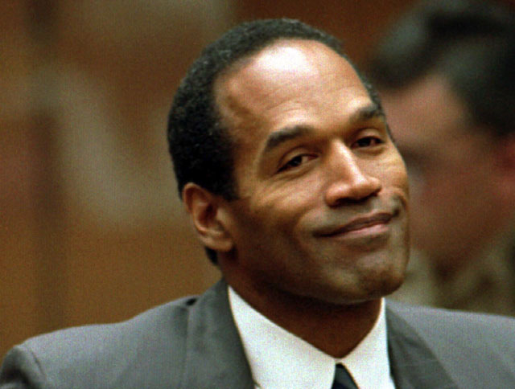
Steps in a Civil Case
Plaintiff – one who brings charges to court
Defendant – accused
Steps…….

Slide 18
Hiring a Lawyer
Usually hired at 1/5 to ½ of money won in lawsuit
Agreed upon fee if case is lost

Slide 19
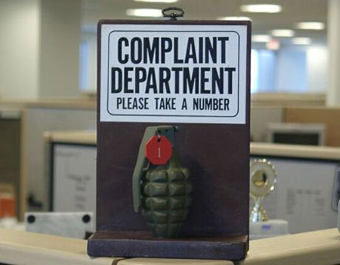
Filing the Complaint
Complaint – accusation filed in a court
Summons – defendant’s official notice to appear
Answer – response to charges

Slide 20
Resolution without Trial
Settlement – settle on price outside court
Mediation – professional tries to calm both sides down
Arbitration - professional hears both sides and makes decision

Slide 21
Trial & Award
Judge or Jury (6-12)
Amount can be changed after hearing case

Slide 22
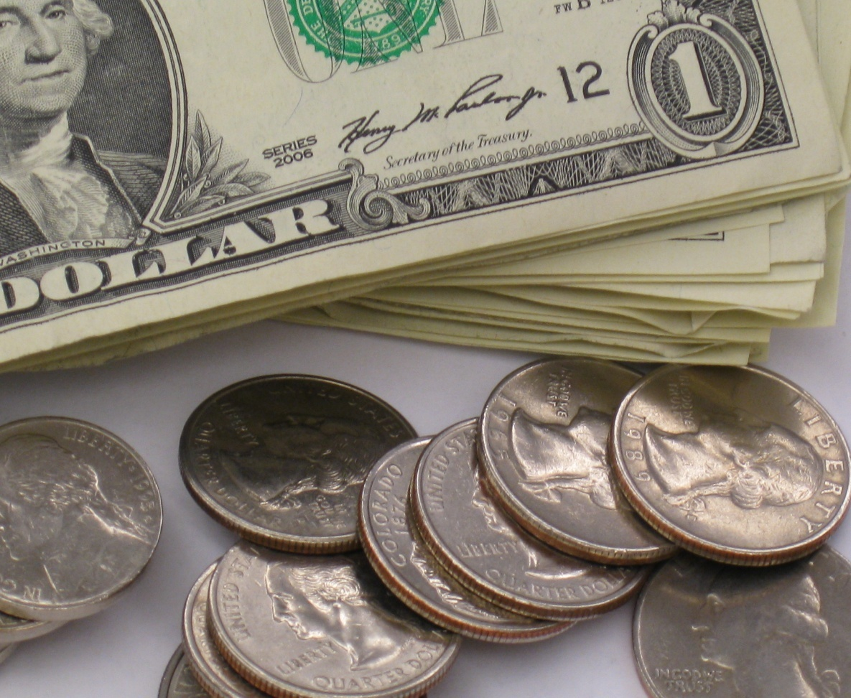
Small Claims Court
$10-15 claim fee
$1000-5000 cases
Small business, renting apts, etc

Slide 23
Criminal Law

Slide 24
Criminal Law
“defines criminal acts and spells out punishments for them”
Justice System – all responsible for enforcing the law

Slide 25
Types of Crimes
Petty Offense – minor crimes (tickets)
Misdemeanors – serious crimes (fines and jail)
Felony – very serious crimes (prison over a year)

Slide 26
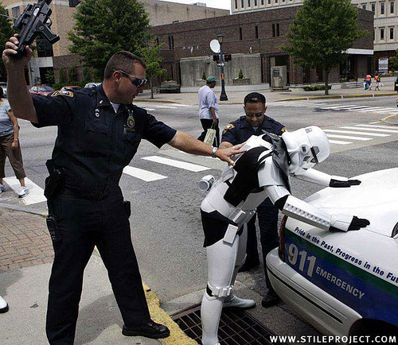
Investigation & Arrest
Arrest Warrant – order signed by judge that has crime and one to be arrested
“booked” at police station

Slide 27
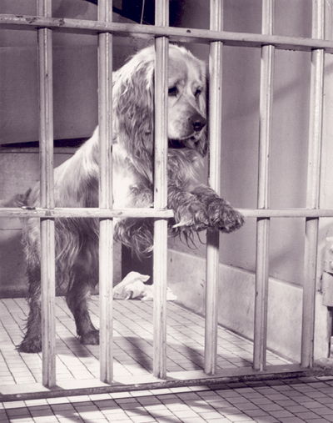
Initial Appearance
Accused brought to judge within 24 hours
Misdemeanor – give plea
Bail set

Slide 28
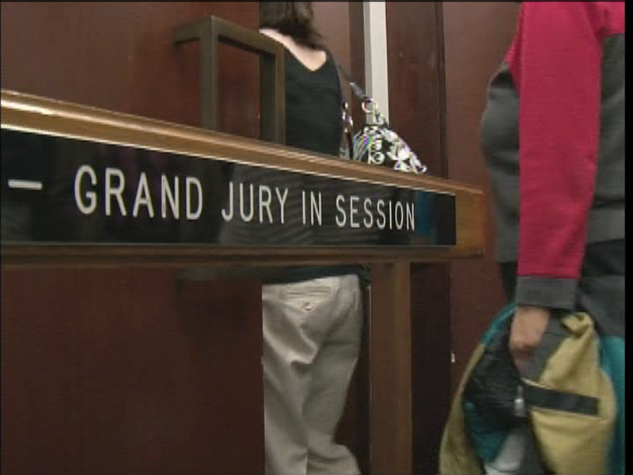
Grand Jury
Citizens to look at evidence to see if there should be a case
Most go with advice of prosecution
Many see it useless

Slide 29
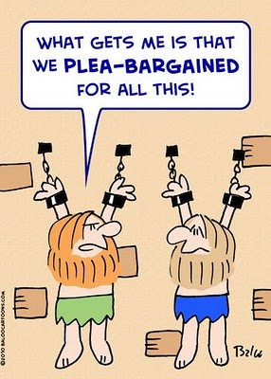
Plea Bargaining
Agree to lesser crime or fewer crimes in return for guilty plea
Saves money and time

Slide 30
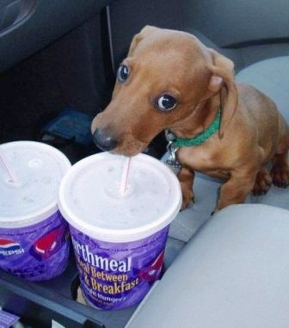
Plea
Not Guilty
Not guilty by reason of insanity
Guilty
No Contest

Slide 31
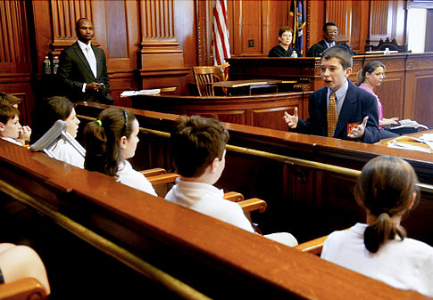
The Trial
Jury or Judge
Witnesses
Evidence

Slide 32
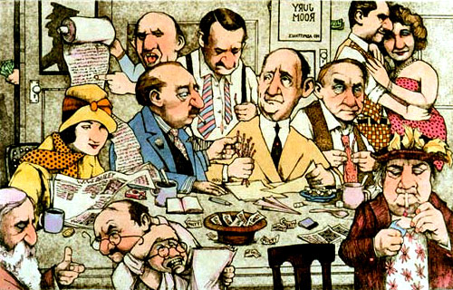
Decision
Jury – deliberates with no time limit
Guilty verdicts need to be unanimous
Hung Jury cant decide

Slide 33
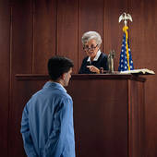
Sentencing
Law gives a max and min
Judge decides length
Judge puts all factors into sentencing
3 strike rule

Slide 34
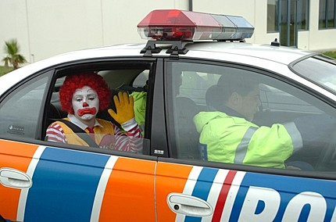
Rights of the Accused

Slide 35
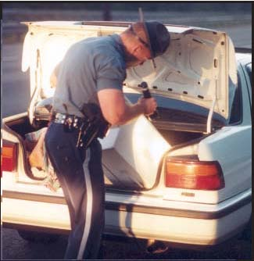
Search and Seizure
Warrants needed to search
If you see it done or have probable cause no warrant needed
You can search garbage outside home

Slide 36
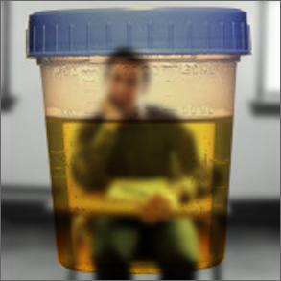
Misc Stuff
Exclusionary Rule -Excludes illegally obtained evidence
Students can be drug tested w/out probable cause
No wiretaps w/out warrant

Slide 37
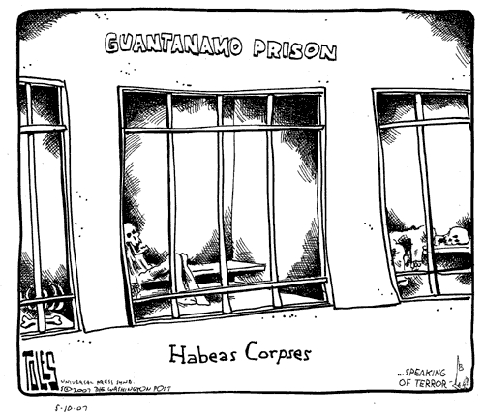
Habeas Corpus
Order to bring person in custody to court and explain why being held
Allowed to be suspended during war times

Slide 38
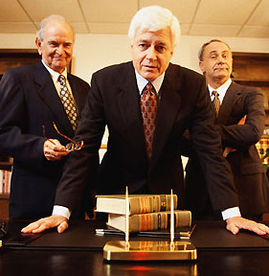
Counsel
Lawyers appointed for defense

Slide 39
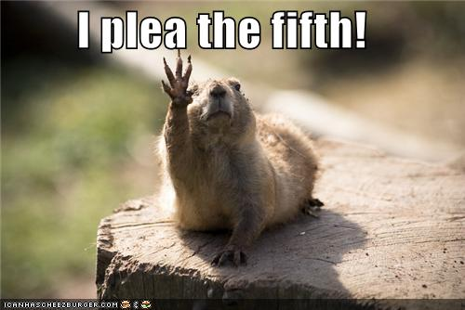
Self-Incrimination
Don’t have to witness against yourself

Slide 40
Double Jeopardy
Tried twice for the same crime
Exceptions:
One act two crimes
Federal and state laws broke
Jury fails to agree on verdict

Slide 41
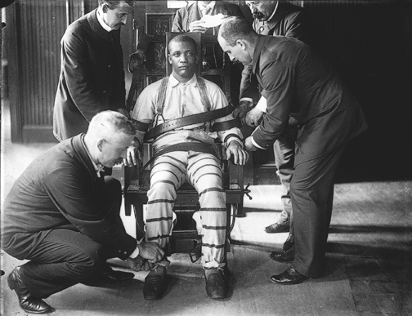
Death Penalty
Cruel and Unusual?
DNA’s impact both support and against Death Penalty

